Slide 1
Disabilities Awareness
Colin Alesse
Troop 235
Mount Prospect, IL
Notes:
Material Sources:
Disabilities Awareness Merit Badge Book, Boy Scouts of America
Three Fires Council, St. Charles, IL, Special Needs Committee

Slide 2
Before we get started
Take attendance
Merit Badge blue card ?
Merit Badge Workbook optional
Lots of resources on line
www.scouting.org
www.meritbadge.org

Slide 3
Sign In (Print Your Name)
First Name | Last Name
First Name | Last Name

Slide 4
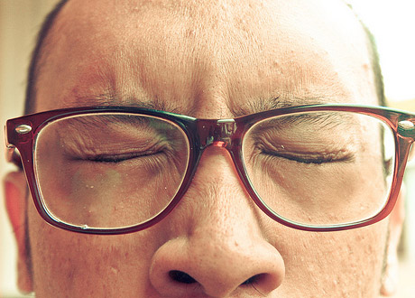
Disability Etiquette
The disability is not the person
See the person and treat them as an individual
The way you like to be treated

Slide 5
Tips for Disability Etiquette
RELAX and be yourself.
Treat people with friendship and respect.
It is always appropriate to smile and say hello
It is ok to shake hands. When in doubt ask.
Do not lean on a persons wheelchair
When you talk with someone in a wheel chair sit down so you are at eye level.
Do not touch or move a person’s wheel chair, crutches, cane, or other gear without permission.
Be patient if a person with a disability takes a little extra time to do or say something.
When you talk with someone who has difficulty speaking, never pretend to understand if you do not.
Speak in a normal voice.
Never pet or play with service animals.
Ask before giving help.
Offer your arm to a person who has a visual impairment.
When talking with someone who is hard of hearing, first get the persons attention with a light tap on the shoulder or make eye contact before you speak. Let the person choose the means of communication, such as lip-reading, sign language, or writing notes.
When talking with someone who is blind, identify yourself and anyone with you by name. Let the person know when you are leaving.
If you want to know more about someone’s disability, it is OK to ask politely.

Slide 6
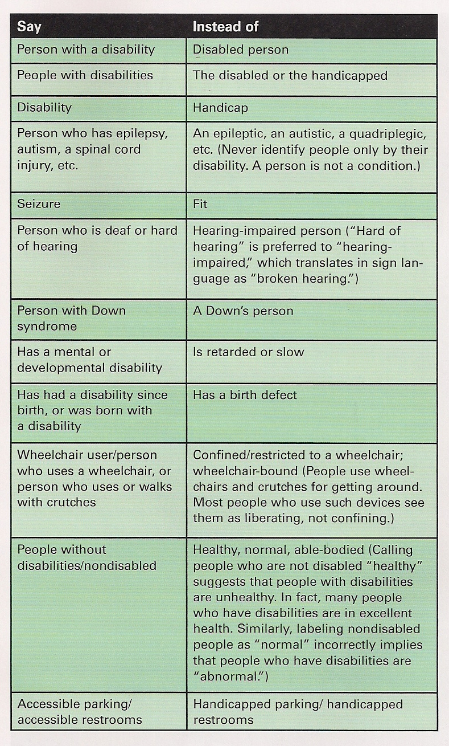
Person 1st Language
The idea behind person first language is to emphasize the person not the disability.

Slide 7
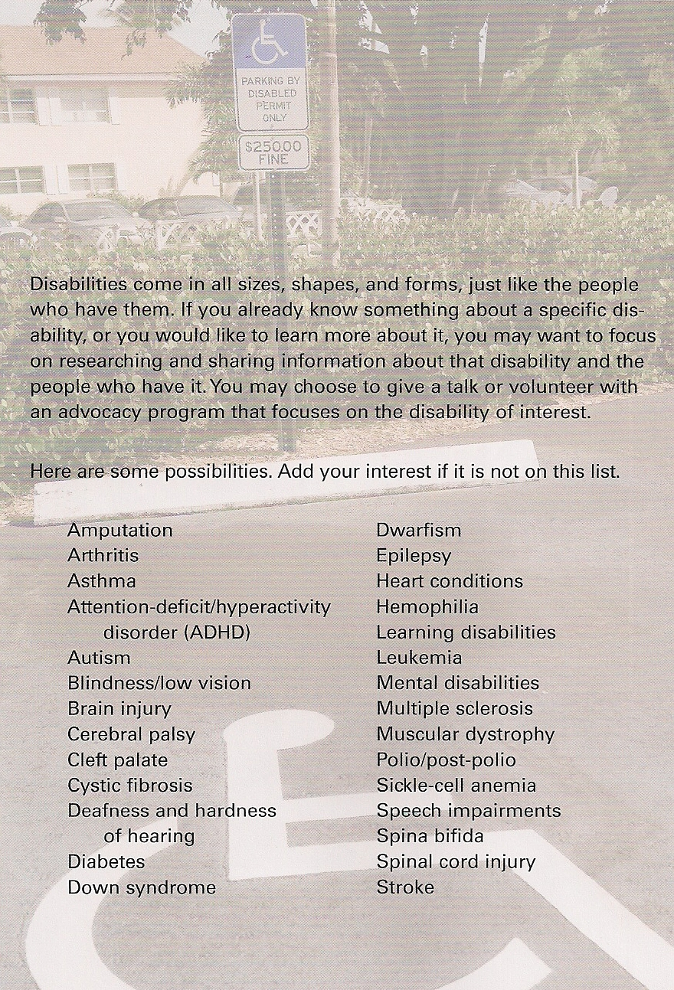
What is a disability?
Disability v. Problem
Types of Disabilities
Notes:
A disability is a real and permanent medical condition and cannot be eliminated
A problem is made by individuals and can and should be eliminated. A disability can sometimes cause a problem in behavior, in learning, and/or in socialization.
Disabilities can be physical or mental and include learning disorders

Slide 8
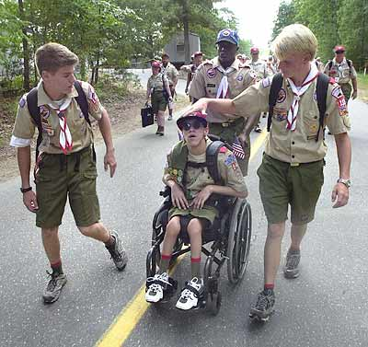
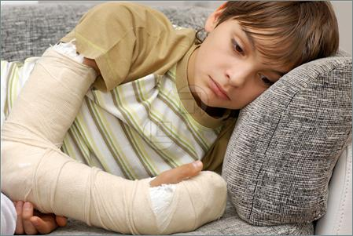
Can you tell who has a disability ?
Broken Leg
Unable to walk
Broken Arm
Notes:
The following slides can be used in the presentation format or as an interactive exercise using a poster board. The scouts would need to place the pictures on one side or the other for disabilities or no disabilities.

Slide 9
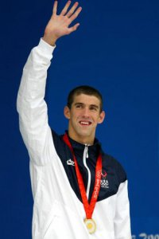
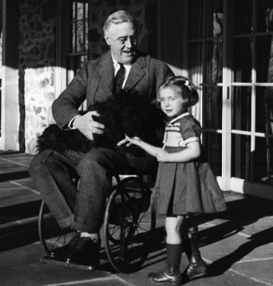
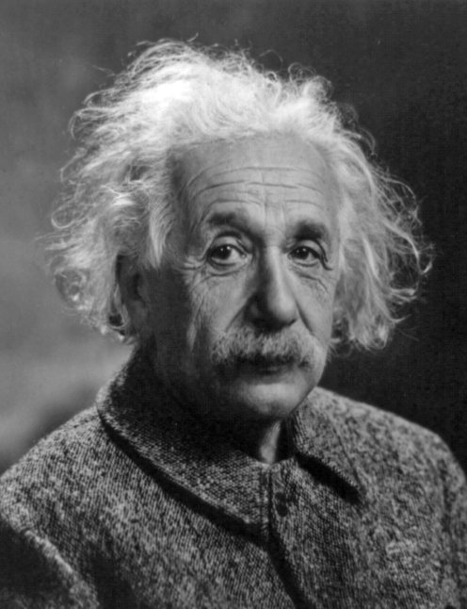
Can you tell who has a disability ?
Michael Phelps
Olympic Swimmer
Diagnosed with ADHD
Franklin Delano Roosevelt
32th American President
Contracted Polio and unable
to walk without assistance
Albert Einstein
Theoretical Physicist and Violinist. Speculated to have had Asperger syndrome
Notes:
Michael Phelps
Source: http://health.howstuffworks.com/mental-health/mental-disorders/15-celebrities-with-mental-health-disorders7.htm
Michael Phelps (born June 30, 1985) is a retired American swimmer and the most decorated Olympian of all time, with a total of 22 medals. Michael Phelps has risen to stardom at a fairly young age, and Deborah Phelps, Michael's mother, said she wanted to share Michael's story and his struggles with attention deficit hyperactivity disorder (ADHD). Diagnosed when he was 9 years old, Phelps had trouble concentrating in school, his mother said, but personally prescribed medication and swimming helped Phelps manage the disorder.
Franklin Delano Roosevelt
Source: http://fdr-disability-rights-award.org/Franklin_Delano_Roosevelt.asp
Roosevelt was the only president to enter office with a physical disability. In 1920 Roosevelt served as New York state senator and assistant secretary of the Navy and run as James M. Cox’s vice president on the Democratic presidential ticket. But after losing to Republicans Warren G. Harding and Calvin Coolidge, the 38-year-old Roosevelt left public life, however, to become vice president of Fidelity and Deposit Company of Maryland.
But, In 1921 while on a vacation in Nova Scotia, Roosevelt contracted polio. In a 1924 letter to Dr. William Egleston, he wrote:
“First symptoms of the illness appeared in August, 1921 when I was thoroughly tired from overwork. I first had a chill in the evening which lasted practically all night. The following morning the muscles of the right knee appeared weak and by afternoon I was unable to support my weight on my right leg. That evening the left knee began to weaken also and by the following morning I was unable to stand up. This was accompanied by a continuing temperature of about 102 and I felt thoroughly achy all over. By the end of the third day practically all muscles from the chest down were involved. Above the chest the only symptom was a weakening of the two large thumb muscles making it impossible to write. There was no special pain along the spine and no rigidity of the neck.” ¹
Although he recovered some strength in his legs, Roosevelt was fitted with heavy braces that eventually allowed him to stand and even walk, with canes, using a rocking motion from his hips. When not in public, however, he got around with the help of a wheelchair.’ Some biographers and commentators spread the misconception that Roosevelt took great pains to hide his infirmity, in collusion with the news media. Ambassador William vanden Heuvel, chairman emeritus of the Roosevelt Institute, disputed that claim in a recent letter to New York Times. “He did not conceal his physical limitation except to prevent his opponents from making political capital out of it,” the ambassador wrote. Some Republicans tried to attack the President as “a cripple” unfit to serve, but dropped the strategy after they ran into a brick wall of public opinion,” Ambassador vanden Heuvel wrote. ²
“To F.D.R., this was not ‘a sickness’ – one of the reasons he is an icon for people with disabilities. He educated American’s to understand that disability is not illness and that we can master the limitations caused by disability,” Vanden Heuvel added.
Still, FDR was concerned the public would view him as weak and only allowed one family photo of himself in a wheelchair. Though he never made a point of his disability nor tried to use it to gain sympathy. But, as he letter to Dr. Egleston shows, he was always ready to talk about it and was often photographed standing arm-in-arm with a family member or aide for support. His very visible support of polio research and therapy helped create the March of Dimes that led eventually to an effective vaccine and the Warm Springs Rehabilitation Center.
And because he never made a point of it, neither did the news media, particularly in those days when reporters were more willing to draw a distinction between a president’s public and private lives. Rather than a “cover-up” it was simply overshadowed by the force of the man’s personality and the momentous events of his four terms in office. In that same spirit, the Disability Rights Award named in his honor seeks to encourage United Nations member states to accept their citizens with disabilities as vital and productive members of their societies and economies, and to remove the barriers to achieving their potentials.
¹ Courtesy: http://fdrlibrary.marist.edu/education/resources/month_august.html ² www.nytimes.com
Albert Einstein
Source: http://rarediseases.about.com/cs/aspergersyndrome/a/041003.htm
Although the behaviors known as Asperger syndrome were first described in the 1940s, the diagnosis was not officially recognized until 1994. Since Einstein and Newton lived before then, it is difficult to come to a definitive answer, since neither can be questioned or examined now. What the researchers noted in biographical information about both men were behaviors seen with Asperger syndrome, such as: limited but intense range of interests, especially specific intellectual areas difficulty in social relationships, especially responding appropriately to others problems communicating, such as difficulty making conversation or understanding others The researchers pointed out that Einstein was a loner as a child and often repeated sentences obsessively until he was seven years old. His career was centered on complex mathematical topics. He gave very confusing lectures. As for Newton, the researchers noted that he hardly spoke, had few friends and was often bad-tempered around them. He often became so engrossed in his work (the science of physics) that he forgot to eat. He always gave his scheduled lectures, even if no one came.

Slide 10
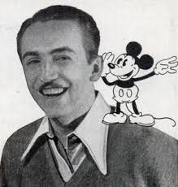
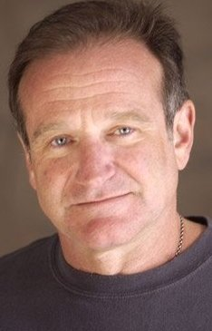
Can you tell who has a disability ?
Walt Disney
American motion-picture and television producer and showman.
Speculated to have had dyslexia
Richard Branson
Billionaire Businessman
Diagnosed with dyslexia
Robin Williams
Comedian and Actor
Diagnosed with ADHD
Notes:
Learning disabilities can be difficult to manage, but they don’t necessarily impact a person’s chances of success. Many celebrities and famous figures from history struggled with learning disabilities, but the disabilities may have been instrumental in shaping their perspectives and helping them find the willpower to achieve their goals.
Source: http://www.vmi.edu/uploadedFiles/Academics/Academic_Support/Disabilities_Services/Famous%20People%20with%20Learning%20Disabilities%20-%20updated.pdf
Richard Branson – A billionaire businessman, Branson credits his business intuition and unique perspectives to his early struggles with dyslexia, which affects the way he visualizes words.
Walt Disney – While no hard evidence exists, many scholars believe that Disney suffered from dyslexia or a related disorder due to his difficulties in school. Disney eventually dropped out of high school and pursued a career as an artist.
Robin Williams – Williams is a comedian and actor, famous for his roles in “Mrs. Doubtfire,” “Good Will Hunting” and dozens of other films. He has been diagnosed with attention deficit hyperactivity disorder (ADHD) which affected his education and his ability to memorize scripts.

Slide 11
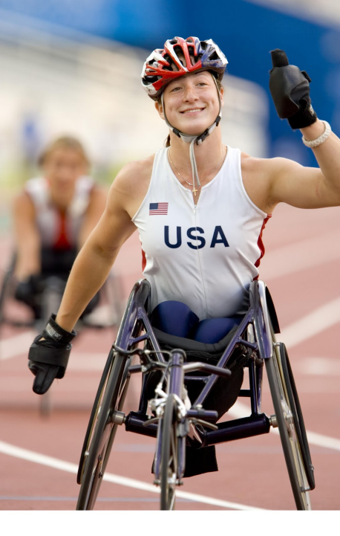
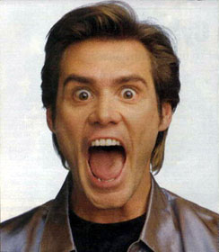
Can you tell who has a disability ?
Tatyana McFadden
Paralympic Athlete
Diagnosed with spina bifida
Jim Carrey
Comedian and Actor
Diagnosed with depression and bipolar disorder
Notes:
Tatyana McFadden Bio
Source: http://www.tatyanamcfadden.com/biography.html
Tatyana McFadden (Clarksville, Md.) is the most decorated athlete on the 2014 Paralympic team with 10 Paralympic medals; however, none of them are from the Paralympic Winter Games. McFadden is making her winter sport debut in Nordic skiing after first gaining international fame in track and field.
At the University of Illinois Tatyana McFadden’s teammates on the school’s wheelchair racing team have nicknamed her Beast. Why? Because Tatyana is strong. In the gym people stop and gawk at how much she is lifting. In a road race spectators marvel at how she flies up hills that bring other racers to a crawl. On the track her competitors hang their heads as they see Tatyana’s rippling shoulders cross the finish line ahead of them. Tatyana is strong as a beast. When Tatyana hears the nickname, however, she giggles. Being strong is not something Tatyana has ever had to think about, it is something that she has embodied her whole life. By all accounts Tatyana should not be one of the top female athletes in the world. She probably should not be alive. She was born in 1988 in St. Petersburg, Russia, with an underdeveloped spinal cord resulting in penalization below the waist and a hole in her spine, a condition know as spina bifida. When operated on immediately, spina bifida is rarely life threatening. Tatyana was left for 21 days before doctors operated. Only her innate strength of will kept her alive. As an unwanted disabled child, Tatyana was immediately sent to an orphanage after her surgery. She grew up in a place so poor they could not buy crayons for the children to color with let alone a wheelchair for Tatyana to get around in. Unfazed, she spent the first six years of her life using her arms as legs and walking on her hands as if the were feet. In 1994, Debbie McFadden, working as the commissioner of disabilities for the U.S. Health Department, visited Tatyana’s orphanage on a business trip. When she met Tatyana, she immediately felt a connection with the young girl and decided to adopt her and bring her to the United States. For Tatyana the adoption meant freedom, it meant a real family, and it meant her first wheelchair, but the excitement was short lived. When she arrived in the US she grew very sick. She was severely anemic and grossly under weight and doctors thought she would only survive a few more months. For a second time in her short life Tatyana’s innate strength would defy the odds. To aid in her recovery Debbie began to enroll Tatyana in various youth sports groups. Tatyana began taking swimming lessons at the local pool and, a year after she arrived in the US, began participating with the Bennet Blazers, a Baltimore, Maryland area wheelchair sports organization. No longer having to use her strength for survival, Tatyana quickly found she could use that strength to excel in athletics. She tried every sport she could find from archery, to ping-pong to basketball, but from the start she fell in love with wheelchair racing. It did not take long for Tatyana’s racing career to take off. In 2004, at the age of 15, she was the youngest member of the USA track and field team at the Athens Paralympic Games, her first international competition. She shocked the world in the process, winning a silver medal in the 100 meters and a bronze in the 200m. Two short years later, Tatyana etched her name in the record books, winning the gold medal in the 100m in world record time at the 2006 IPC World Championships in Assen, Netherlands. She followed that performance with two silver medal performances in the 200m and 400m, securing a spot as a “Beast” in international wheelchair racing heading in the 2008 Beijing Parlaympic Games. Tatyana did not disappoint in Beijing, coming home with four medals, winning silver in the 200m, 400m and 800m and a bronze in the 4x100m relay. Off the track Tatyana is pursuing a degree in Human Development and Family Studies at the University of Illinois, and works as a national advocate for equal access for people with disabilities. Learn more about Tatyana’s off-the-field work in Causes.
Jim Carrey
Source: http://www.famousbipolarpeople.com/jim-carey.html
Born on 17th January 1962, James Eugene "Jim" Carrey is an American comedian and actor. He began performing as a comedian at an early age and then branched into acting. He first worked as an actor in small television and film companies. He took up roles in many movies which were hits in the movie industry. He earned a record amount of 20 million dollars in one of his comedy movies. His movies won awards and he also won personal awards as well.
Jim Carey attended Blessed Trinity Catholic, Agincourt Cellegiate and Northview Heights Secondary Schools. He showed little comedy skills during those times at school. He started stand-up comedy just after school, performing in Toronto, Ontario. He chalked some successes and started to work at the comedy store in Los Angeles. He also worked with Rodney Dangerfield to introduce his tour performances. He began his acting career by auditioning for a position in Saturday Night Live, which he never got. He had his first lead role as an animation producer on NBC. Doctors suggest that Jim's role in the movie “Me Myself and Irene” suggests that he had a split personality and that he could be violent. Later on, Carrey himself made it public and disclosed that he was suffering from depression. At 16, his family had problems that affected him. He and his other siblings had to work as security and janitors. He was angry because of this and became very aggressive. This is a clear sign of depression and could be attributed to bipolar disorder. He got so depressed and sometimes would not talk to anyone but cry. He suffered from depression even at the peak of success, which he publicly acknowledged and asked for help. He acknowledged the “peaks and valleys” At a point when his mother was sick, he used to hit himself on the walls and let himself fall on the stairs. He later admitted to a newspaper that depression was the motivation behind the comedies he produced. Many people attributed his depression to bipolar disorder. He was put on the anti-depressant drug Prozac, which he used for a long time. He managed to get off the drug and now resorts to religion to deal with his depression. Carrey is also speculated to have a chipped tooth, which may have contributed to his low self image and depression. Carrey married twice; first to Melisa Womer whom he stayed with for eight years and had a daughter with her. He then got married to Lauren Holly. Divorcing Holly after a year, he dated several other women, but those relationships never lasted. His last was Jenny McCarthy whom Carey dated five years but announced their breakup in April 2010.
Despite his bouts of depression, Carrey has chalked a lot of success in the movie world. He has won the hearts of many movie fans as a great actor. His comedies are also loved by both young and old. Carrey had a grandchild too, who is the child of his 21 year old daughter. He now lives in Brentwood, California.

Slide 12
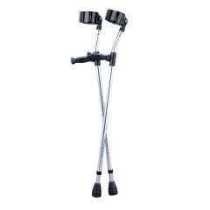
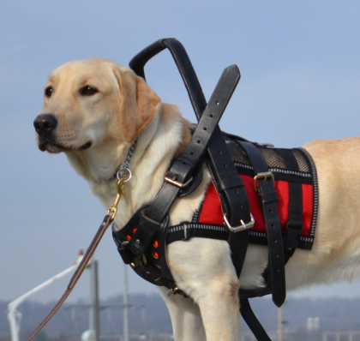
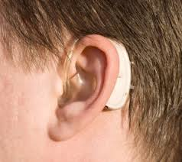
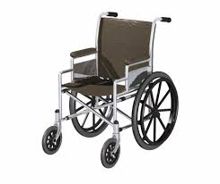
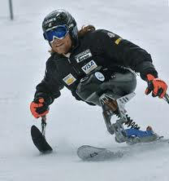
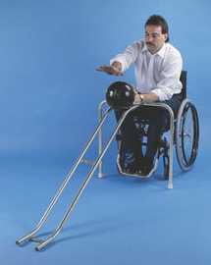
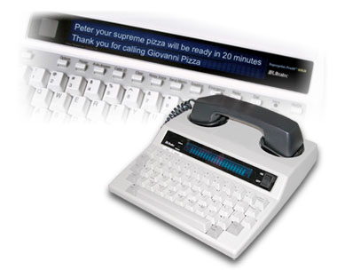
Aids

Slide 13
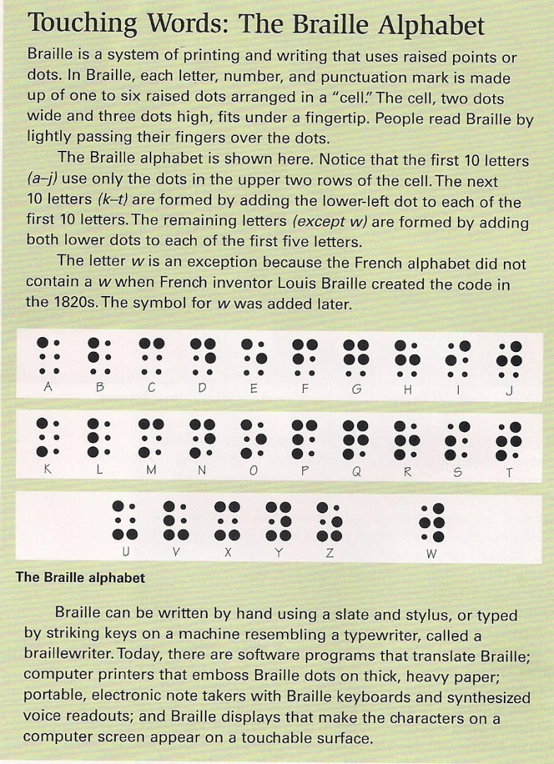
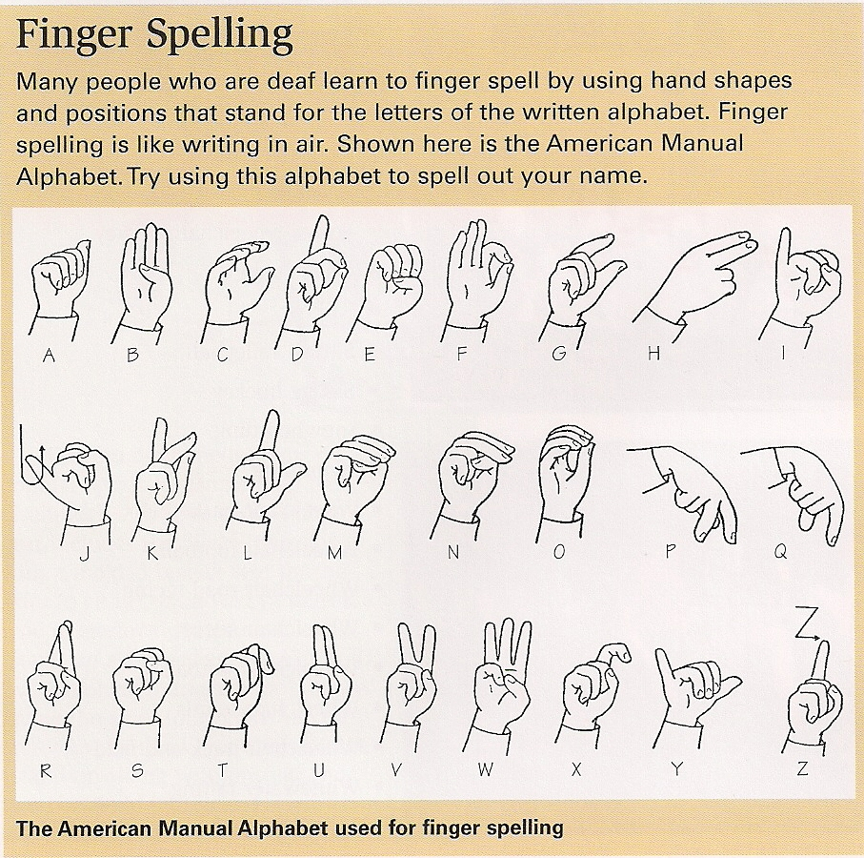
Aids

Slide 14
Disabilities DifferentAbilities
Every Scout has needs
To be successful
To be accepted socially and emotionally
It takes a village
Scouts
Trained Leaders
Parents & Caregivers

Slide 15
3 Keys to Success
Communication
Communication
Communication
What can I do to help?

Slide 16
What is a disability?
REACH out to Scouts and be sure they are part of the group. Plan meetings so every Scout is Successful.
R – Respect
E – Encourage
A – Accept
C – Care
H – Honor

Slide 17
Managing Conflict
Be aware of yourself
Be aware of others
Set the scene for cooperative solutions

Slide 18
Approaches
Cooperative Approach
Direct Approach (Must Stop Now - Freeze)
Typically when safety is involved
This is what is expected
This is what you are doing
This is why you must stop and change

Slide 19
Cooperative Approach
Actively Listen
Seek first to understand, then be understood
Connects us with others
It helps us make decisions and solve problems
Don’t let the heat of the moment take over you
Sometimes you need to take a break to get to a “good place” first
focused, fed, warm, cool, no headache, etc.

Slide 20
Advocacy
Advocacy means supporting, promoting, or encouraging something
Support and encourage positive attitudes
Help strip away labels
Help people see each other as individuals
Build bridges of understanding and respect
Bullying
Children with disabilities are 2-3X more likely to be bullied
More than 50% of bullying situations stop when a peer
The end of bullying begins with you
Notes:
You may have additional protections under federal law when the bullying is about:
■ Race, color, or national origin
■ Sex
■ Religion
■ Disability
State and local laws may provide additional protections on other bases, including sexual orientation.
Some adults may not know this, so clue them in and keep talking until someone understands. Visit www.Olweus.org for an interactive map leading to each state law. No matter what you call it, bullying is painful. But you don’t have go through it alone! There are people who will help you, and it is your right to be safe
The mission of PACER Center (Parent Advocacy Coalition for Educational Rights) is to expand opportunities and enhance the quality of life of children and young adults with disabilities and their families, based on the concept of parents helping parents.
Founded in 1977, PACER Center was created by parents of children and youth with disabilities to help other parents and families facing similar challenges. Today, PACER Center expands opportunities and enhances the quality of life of children and young adults with disabilities and their families. PACER is staffed primarily by parents of children with disabilities and works in coalition with 18 disability organizations. With assistance to individual families, workshops, materials for parents and professionals, and leadership in securing a free and appropriate public education for all children, PACER's work affects and encourages families in Minnesota and across the nation.
Source:
http://www.pacer.org/publications/bullypdf/BP-17.pdf
Information provided by: PACER’s National Bullying Prevention Center®
ACTion Sheet BP-17
Source:
http://www.pacer.org/bullying/pdf/NBPC-flyer.pdf
Information provided by: PACER’s National Bullying Prevention Center®
PACER.org/Bullying
PACERKidsAgainstBullying.org
PACERTeensAgainstBullying.org

Slide 21
Break for Interactive activities
Notes:
The slides at the end of this presentations are interactive activities centered around Autism and Scouting and were provided by: Kelly Behnke, NWSC, Pathfinder Unit Commissioner
I found many resources on the internet but one that really cover a lot of activities can be found at the site below:
http://www.vcu.edu/partnership/C-SAL/downloadables/PDF/DisabilityAwarenessPacket.pdf

Slide 22
Professions
Physical Therapist
Special Education Teacher
Audiologist
Speech Therapist or Language Pathologist
Psychologist
Physician
Occupational Therapist
Clinical Social Worker

Slide 23
Personal Commitment
Make a commitment to your merit badge counselor describing what you will do to show a positive attitude about people with disabilities and to encourage positive attitudes among others.

Slide 24
Requirements covered
1 Disability etiquette, 1st person language
3c How people with disabilities take part in adaptive sports or activity
3d Independent living aids
5 (partial) Advocacy
6 (partial) Make a commitment to show and encourage a positive attitude
7 (partial) Five professions that deal with disabilities

Slide 25
Requirements to complete
Req #2 Visit an agency that works with people with physical, mental, emotional, or educational disabilities. Collect and read information about the agency’s activities. Learn about opportunities its members have for training, employment, and education. Discuss what you have learned with your counselor.
Req #4 Visit TWO of the following locations and take notes about the accessibility to people with disabilities. In your notes, give examples of five things that could be done to improve upon the site and five things about the site that make it friendly to people with disabilities. Discuss your observations with your counselor.
Your school
Your place of worship
Your Scout camping site
A public exhibit or attraction (such as a theater, museum, or park)
Req #5 Do ONE of the following advocacy activities:
Present a counselor-approved disabilities awareness program to a Cub Scout pack or other group. During your presentation, explain and use person-first language.
Find out about disability awareness education programs in your school or school system, or contact a disability advocacy agency. Volunteer with a program or agency for eight hours.
Using resources such as disability advocacy agencies, government agencies, the Internet (with your parent’s permission), and news magazines, learn about myths and misconceptions that influence the general public’s understanding of people with disabilities. List 10 myths and misconceptions about people with disabilities and learn the facts about each myth. Share your list with your counselor, then use it to make a presentation to a Cub Scout pack or other group.

Slide 26
Requirements to complete
Req #6 Make a commitment to your merit badge counselor describing what you will do to show a positive attitude about people with disabilities and to encourage positive attitudes among others. Discuss how your awareness has changed as a result of what you have learned.
Req #7 Name five professions that provide services to people with disabilities. Pick one that interests you and find out the education, training, and experience required for this profession. Discuss what you learn with your counselor, and tell why this profession interests you.

Slide 27
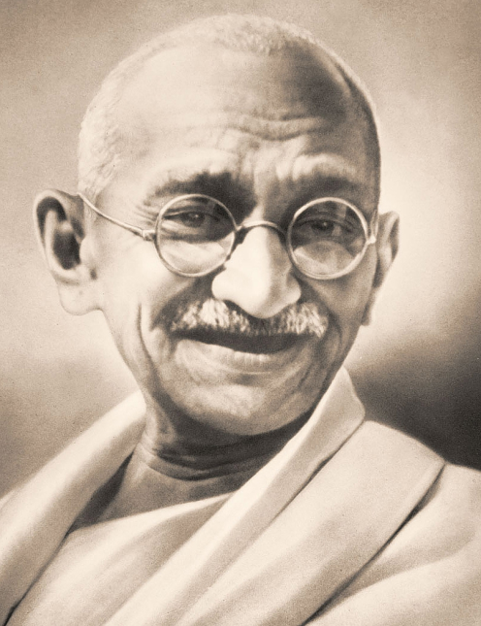
“Be the change you want to see in the world” -Mahatma Gandhi
Notes:
Mohandas Karamchand Gandhi. (2014). The Biography.com website. Retrieved 08:02, May 19, 2014, from http://www.biography.com/people/mahatma-gandhi-9305898.
Harvard Style
Mahatma Gandhi Biography
Anti-War Activist (1869–1948)
Mahatmas Gandhi was the primary leader of India's independence movement and also the architect of a form of civil disobedience that would influence the world.
Synopsis
Born on October 2, 1869, in Porbandar, India, Mahatma Gandhi studied law and came to advocate for the rights of Indians, both at home and in South Africa. Gandhi became a leader of India's independence movement, organizing boycotts against British institutions in peaceful forms of civil disobedience. He was killed by a fanatic in 1948.
Spiritual and Political Leader
Indian nationalist leader Mohandas Karamchand Gandhi, more commonly known as Mahatma Gandhi, was born on October 2, 1869, in Porbandar, Kathiawar, India. He studied law in London, England, but in 1893 went to South Africa, where he spent 20 years opposing discriminatory legislation against Indians. As a pioneer of Satyagraha, or resistance through mass non-violent civil disobedience, he became one of the major political and spiritual leaders of his time. Satyagraha remains one of the most potent philosophies in freedom struggles throughout the world today.
Fight for Indian Liberation
In 1914, Gandhi returned to India, where he supported the Home Rule movement, and became leader of the Indian National Congress, advocating a policy of non-violent non-co-operation to achieve independence. His goal was to help poor farmers and laborers protest oppressive taxation and discrimination. He struggled to alleviate poverty, liberate women and put an end to caste discrimination, with the ultimate objective being self-rule for India.
Following his civil disobedience campaign (1919-22), he was jailed for conspiracy (1922-24). In 1930, he led a landmark 320 km/200 mi march to the sea to collect salt in symbolic defiance of the government monopoly. On his release from prison (1931), he attended the London Round Table Conference on Indian constitutional reform. In 1946, he negotiated with the Cabinet Mission which recommended the new constitutional structure. After independence (1947), he tried to stop the Hindu-Muslim conflict in Bengal, a policy which led to his assassination in Delhi by Nathuram Godse, a Hindu fanatic.
Death and Legacy
Even after his death, Gandhi's commitment to non-violence and his belief in simple living—making his own clothes, eating a vegetarian diet and using fasts for self-purification as well as a means of protest—have been a beacon of hope for oppressed and marginalized people throughout the world.

Slide 28
Interactive Activities
SOUND STATION
Have participants put on a pair of headphones. An adult will turn on the music player. For the next 20 seconds, try talking to the participant sitting across from you while they have music playing in their headphones. One side of the table will listen to the CD, while the other side attempts to talk with the table of “listeners”. Then you will switch roles.
ASK THEM: On a scale of 1 to 5 (5 means “very hard to have a conversation” and 1 means “not hard to have a conversation”), rate how you felt during the conversation.
INFORMATION:
This is the most commonly recognized form of sensory impairment. Hearing impairments can affect someone's ability to communicate and possibly also their balance. People with Autism may experience the following:
under- sensitive to sound:
*They may only hear sounds in one ear, having only partial hearing or none at all in the other.
*They may not acknowledge particular sounds.
*They might enjoy crowded, noisy places or bang doors and objects.
over- sensitive to sound:
*Noise can be magnified and sounds become distorted and muddled.
*People with Autism are so sensitive to sound that they can, for example, hear distant conversations as if they are in the conversation.
*People with Autism may have an inability to cut out sounds – notably background noise, which often leads to difficulties concentrating. Sometimes having good hearing means that all of the different noises get really LOUD and distracting and it can hurt their ears. They may hit their heads to deal with the noises.
*People with Autism might cover their ears or say words to themselves to focus on something else so that the noises they hear don’t seem so loud.
Ways to help:
Under-sensitivity:
Use visual supports to back up verbal information.
Over-sensitivity:
Shut doors and windows to reduce external sounds.
Prepare a person before going into the noise.
Suggest that they wear earplugs.
Lower your own speaking voice
Notes:
Autism and Scouting
Interactive Activities provided by: Kelly Behnke, NWSC, Pathfinder Unit Commissioner

Slide 29
Interactive Activities
SIGHT STATION
Have participants put on blindfold or black goggles. After 15/20 seconds, have them remove goggles, asking them to try to not blink for 15 seconds.
ASK THEM: On a scale of 1 to 5 (5 means “you had to rub your eyes, or your eyes started to tear up,” and 1 means “you felt no discomfort at all”), rate yourself on how sensitive your eyes were to the light.
INFORMATION:
under-sensitive to light:
*Objects appear quite dark, or lose some of their features.
*Main vision is blurred but peripheral vision quite sharp.
*An object in front of them is magnified but things on the periphery are blurred.
*Poor depth perception – problems with throwing and catching; clumsiness.
over-sensitive to light:
*Distorted vision: objects and bright lights can appear to jump around.
*Images may fragment or break apart
*Easier and more pleasurable to focus on a detail rather than the whole objects
*Your friends with autism see a lot of small things that other people don’t notice like every single color in a room.
•When something is out of place, they may become upset. They might cry or flap their hands, twist their bodies, or tap on a desk. This is for comfort.
Ways to help
Small changes to the environment can make a difference.
Three points to remember are:
*be aware: look at the environment to see if it is creating difficulties for people with Autism. Can you change anything?
*be prepared: tell people with Autism about possible sensory stimuli they may experience in different environments.
*be understanding and kind: ask the person if they need to step out of the room for a moment, they may not be able to recognize what is causing their uneasiness.
Notes:
Autism and Scouting
Interactive Activities provided by: Kelly Behnke, NWSC, Pathfinder Unit Commissioner

Slide 30
Interactive Activities
TASTE STATION
Give participants a piece of sour candy. Have them suck on the piece of sour candy for 15 seconds without eating or chewing or spitting out.
ASK THEM: On a scale of 1 to 5 (5 equals “you had to spit it out,” and 1 equals “you liked the taste”), rate yourself on how sensitive you were to the taste of the candy.
INFORMATION:
Chemical receptors in the tongue tell us about different tastes - sweet, sour, spicy and so on. People with an ASD may experience the following differences.
Under-sensitivity to taste:
*Likes very spicy foods.
*Eats everything - soil, grass, Play-dough. This is known as pica.
Over-sensitivity to taste:
*Finds some flavors and foods too strong and overpowering because of very sensitive taste buds. Has a restricted diet.
*Certain textures cause discomfort; some children will only eat smooth foods like mashed potatoes or ice-cream or plain noodles.
*People with sensitive tastes can vomit and feel sick at the taste of certain textures or flavors of food.
Ways to help
*Do not mix sauces in foods. Let people put their own sauces on food like spaghetti and spaghetti sauce, or ketchup on burgers.
*Ask the person with Autism what foods they like. Ask a parent what foods can be eaten by their child with Autism. Provide a fruit alternative.
*Never make fun of a person with special dietary needs or assume they are being picky eaters.
Notes:
Autism and Scouting
Interactive Activities provided by: Kelly Behnke, NWSC, Pathfinder Unit Commissioner

Slide 31
Interactive Activities
SMELL STATION
Spray a perfume card with the room freshener spray. Have participant hold card under their nose for at least 20 seconds.
ASK THEM: On a scale of 1 to 5 (5 means “you were coughing or gagging,” and 1 means “the smell didn’t bother you at all”), rate yourself on how sensitive you were to the smell.
INFORMATION:
Chemical receptors in the nose tell us about smells in our immediate environment. Smell is the first sense we rely upon. People with an ASD may experience the following differences.
Under-sensitivity to smell:
*Some people have no sense of smell and fail to notice extreme odors (this can include their own body odor).
*Some people may lick things to get a better sense of what they are.
Over-sensitivity to smell:
*Smells can be intense and overpowering. This can cause toileting problems.
*Dislikes people with distinctive perfumes, shampoos, etc.
*Dislikes certain foods. May vomit or get physically ill at the smell of certain foods.
Ways to help
*Ask a parent or the person with Autism if certain smells irritates them.
*Be kind. If a person with Autism has body odor, give them a gentle message.
*If you know a certain food bothers a person, give them notice that the food will be served before it is served to allow person to leave area.
*Use unscented detergents or shampoos, avoid wearing perfume, make the environment as fragrance-free as possible.
Notes:
Autism and Scouting
Interactive Activities provided by: Kelly Behnke, NWSC, Pathfinder Unit Commissioner

Slide 32
Interactive Activities
TOUCH STATION
Have the participant feel the sandpaper in the middle of the board. (Texture is from an average touch sensitivity). Now have the participant feel the sandpaper on the right side of board. (Texture is from under sensitive touch sensitivity). Lastly, have participant feel the sandpaper on the left side of board. (Texture is from over sensitive touch sensory)
ASK THEM: On a scale of 1 to 5 (5 means “very”, and 1 means “not very much"), rate how much difference you felt between the 2 materials.
INFORMATION:
Touch is important for social development. It helps us to assess the environment we are in (is an object hot or cold?) and react accordingly. It also allows us to feel pain. People with an ASD may experience the following differences.
Under-sensitivity to touch
*Holds others tightly - needs to do so before there is a sensation of having applied any pressure.
*Has a high pain threshold.
*May self-harm: bang head, hit head, pick at lip, pick nails until they bleed.
*Enjoys heavy objects (eg, weighted blankets) on top of them.
Over-sensitivity to touch
*Touch can be painful and uncomfortable; people may not like to be touched or hugged and this can affect their relationships with others.
*Dislikes having anything on hands or feet.
*Difficulties brushing and washing hair because head is sensitive.
*Only likes certain types of clothing or textures.
Ways to help
*Know if a person is under or over sensitive and be careful when playing games or shaking hands or tapping their shoulder.
*Warn a person if you are about to touch him or her; always approach him or her from the front.
*Remember that a hug may be painful rather than comforting.
*Allow a person to complete some activities themselves so that they can do what is comfortable for them.
Notes:
Autism and Scouting
Interactive Activities provided by: Kelly Behnke, NWSC, Pathfinder Unit Commissioner

Slide 33
Interactive Activities
MOTOR STATION/BODY AWARENESS
Have participant put on a pair of work gloves. Have participant now tie the shoe lace on the boot.
ASK THEM: On a scale of 1 to 5 (5 means “you had a lot of trouble tying shoe lace,” and 1 means “you had no problem at all tying shoe lace”), rate yourself on tying your shoe lace on the boot.
INFORMATION:
Situated in the muscles and joints, our body awareness system tells us where our bodies are in space, and how different body parts are moving.
Under-sensitivity
*Stands too close to others, because they cannot measure their proximity to other people and judge personal space.
*Hard to navigate rooms and avoid obstructions.
*May bump into people.
*Clumsy. May not be able to do simple movements like jumping jacks.
Over-sensitivity
*Difficulties with fine motor skills: manipulating small objects like buttons or shoe laces.
*Moves whole body to look at something.
Ways to help
*Do not rush person with Autism while doing fine motor tasks.
*Do not laugh at person with Autism when they act clumsy.
*Offer to help tie shoes or button coats.
* If a person with Autism stands too close, give them a gentle reminder to give you more space.
Notes:
Autism and Scouting
Interactive Activities provided by: Kelly Behnke, NWSC, Pathfinder Unit Commissioner

Slide 34
Interactive Activities
WHO’S ON THE AUTISM SPECTRUM
Have participants look at the picture board and place all of the pictures of those people who are on the Autism Spectrum in the middle section of the board.
ASK THEM: On a scale of 1 to 5 (5 means “you had a lot of trouble identifying who was on the spectrum,” and 1 means “you had no problem identifying who was on the spectrum”), rate yourself on identifying who was on the spectrum.
INFORMATION:
You cannot tell who is on the Autism Spectrum and who is not. It has been said, once you know someone with Autism, you only know ONE person with Autism. This means that everyone is different, with different challenges and different needs, and different abilities. Even people with Autism are very different from each other. That is why this disorder is called a SPECTRUM.
Ways to help
Treat everyone the way you want to be treated. Live the Scout Law.
Be KIND to everyone. We never know what challenges people have and we should never judge people.
Be FRIENDLY. People are all different. Everyone has challenges as well as abilities.
Be COURTEOUS. Do not stare at people with challenges, or others who may be having a sensory meltdown. Do not rush another person to finish and activity.
Be HELPFUL. Offer to help when another person seems to be struggling doing an activity. We never know when we may need help ourselves.
Be CHEERFUL. Always reassure a person that they can do it, even if it takes them longer.
Notes:
Autism and Scouting
Interactive Activities provided by: Kelly Behnke, NWSC, Pathfinder Unit Commissioner

