Slide 1
T-235 Nowcasting
By: Patrick Hogan

Slide 2
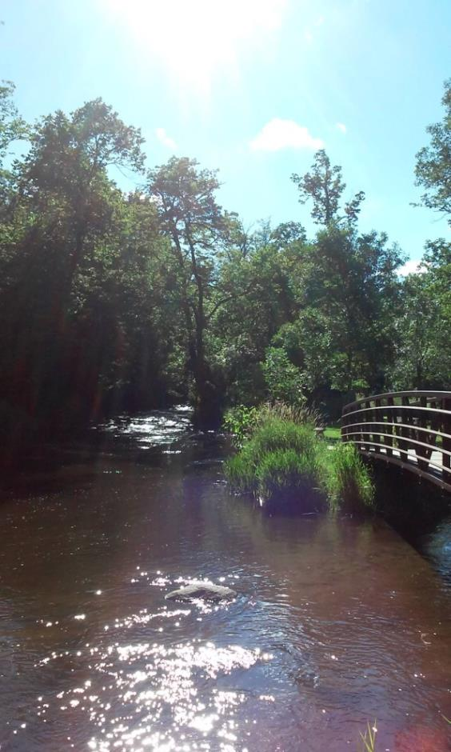
Unfortunately, Every day is not like this…

Slide 3
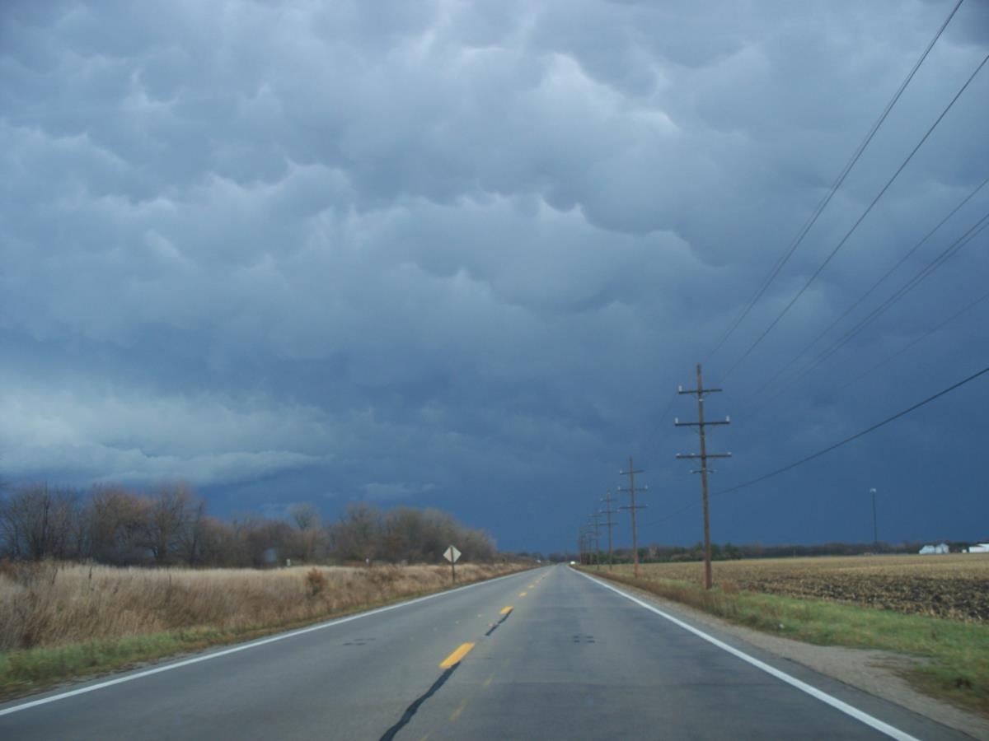
Things can look quite menacing. (mamatus clouds, thunderstorms)

Slide 4
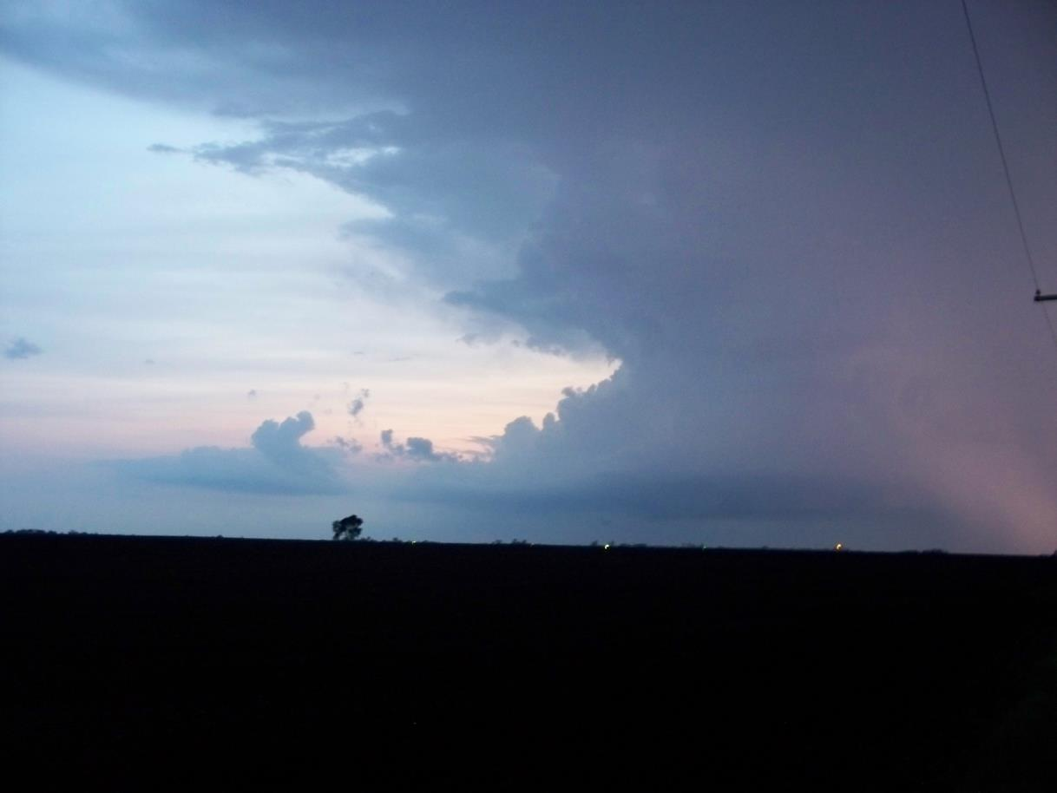
Thunderstorm with anvil and tail cloud.

Slide 5
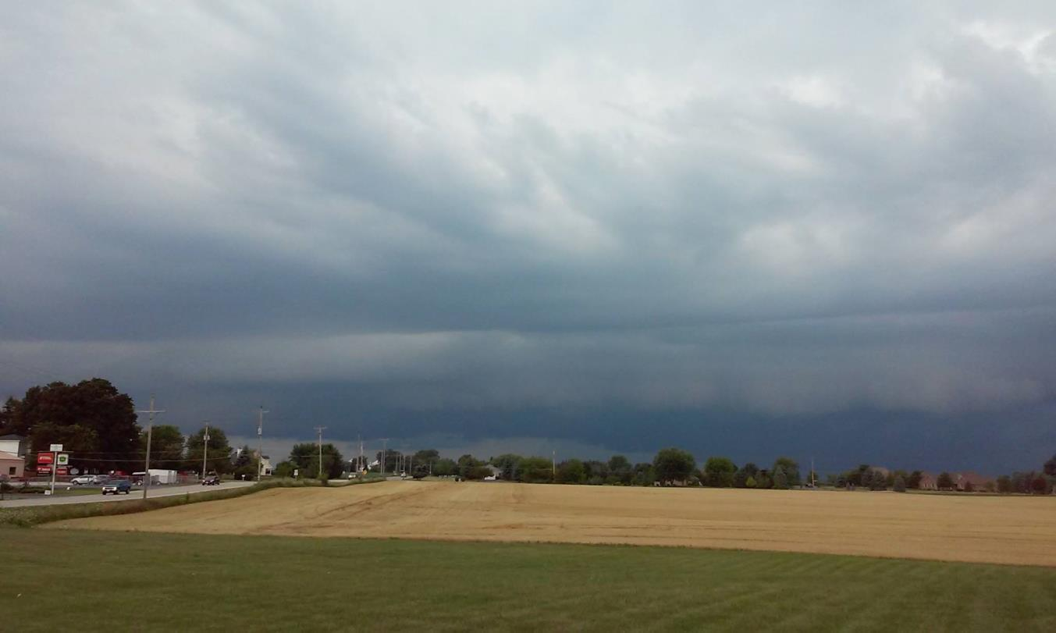
Thunderstorm with shelf forming. Winds, potential hail, and heavy rains possible.

Slide 6
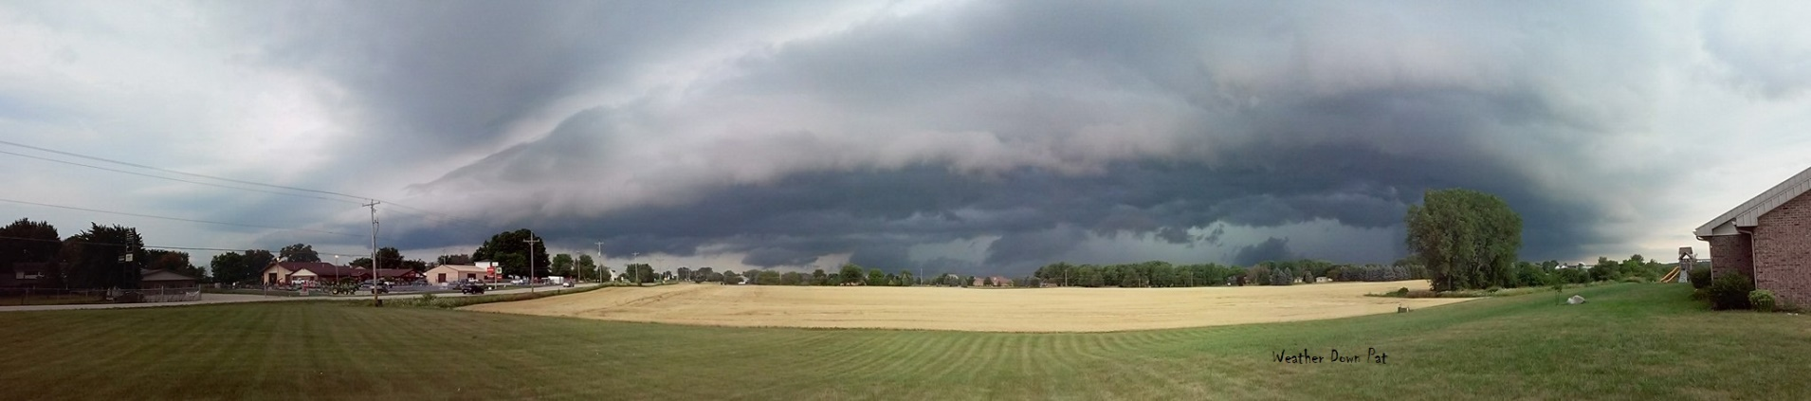
Shelf cloud with scud clouds.

Slide 7
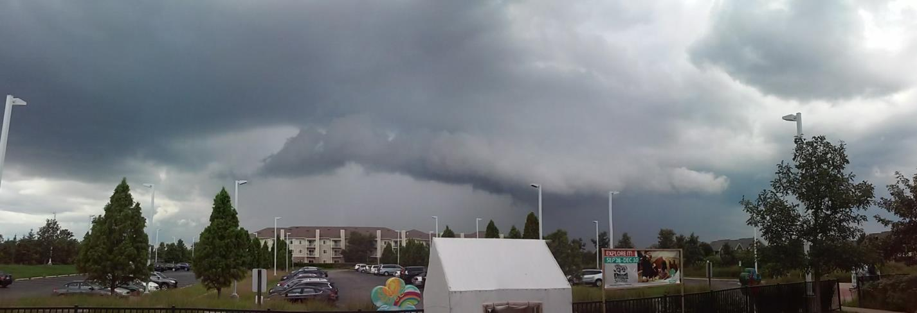
Shelf forming, rain/hail shafts.

Slide 8
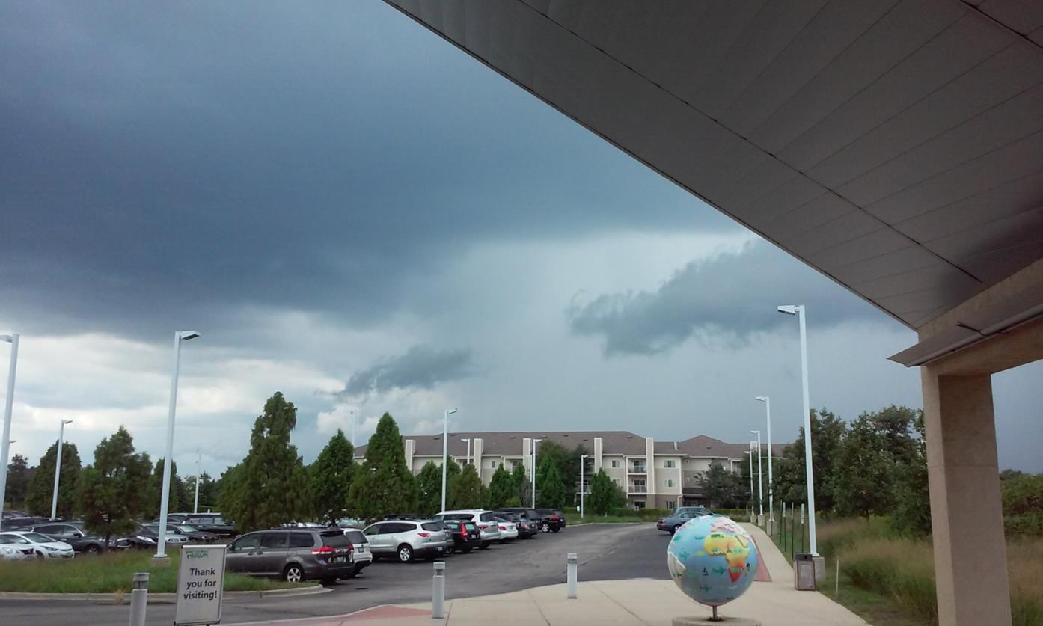
Scud or funnel if rotating.

Slide 9
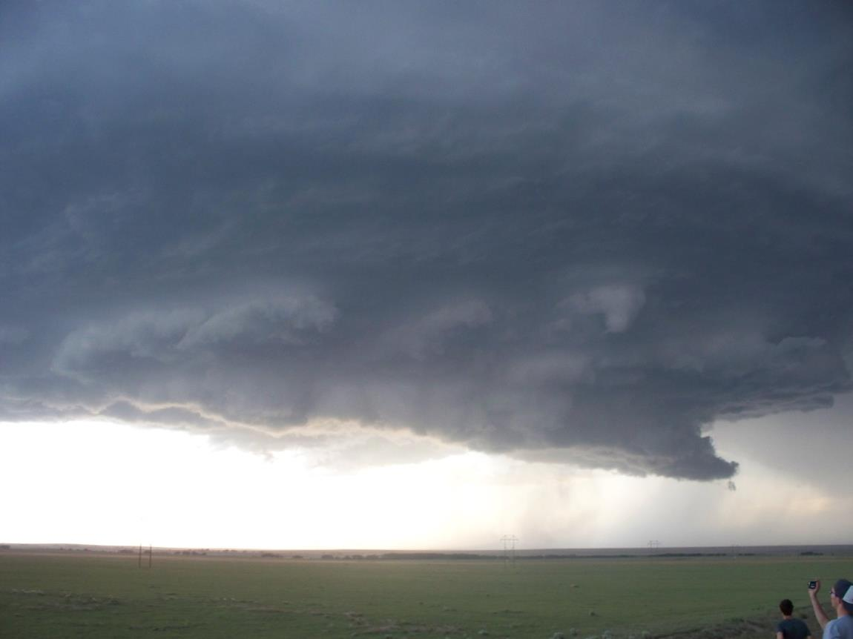
Rotation and wall cloud.

Slide 10
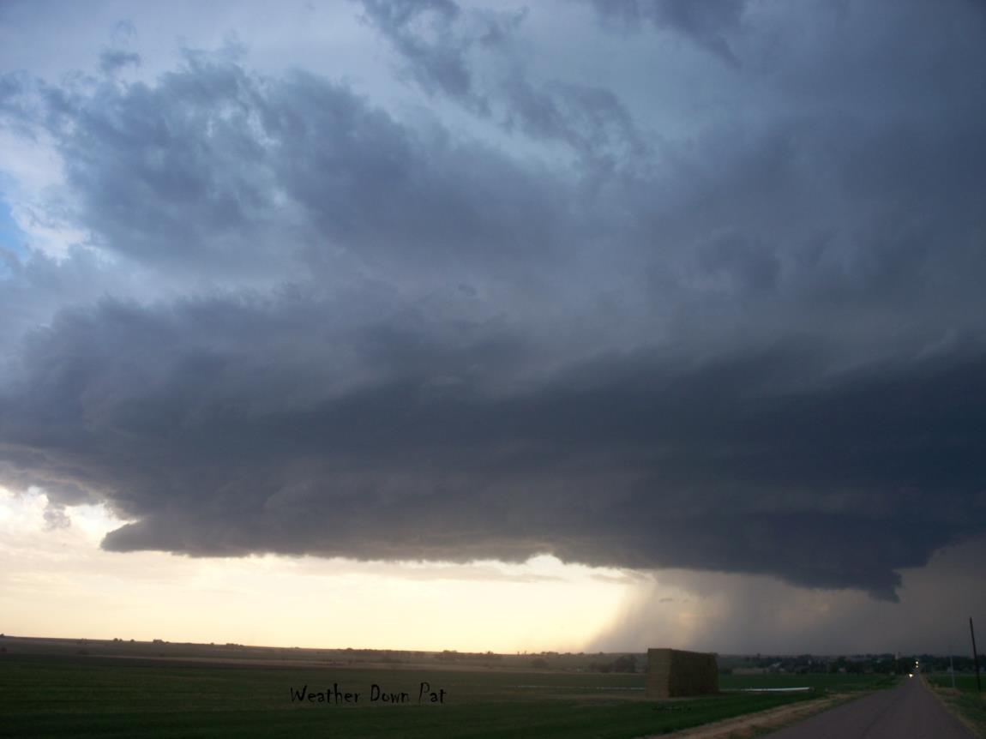
Rotating wall cloud with gust front/rain shafts.

Slide 11
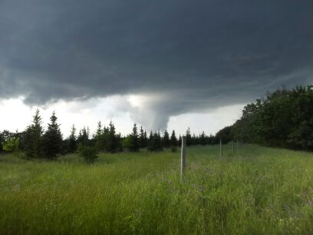
Funnel/lowering , tornado.
Photo credit: Nick Cromer

Slide 12
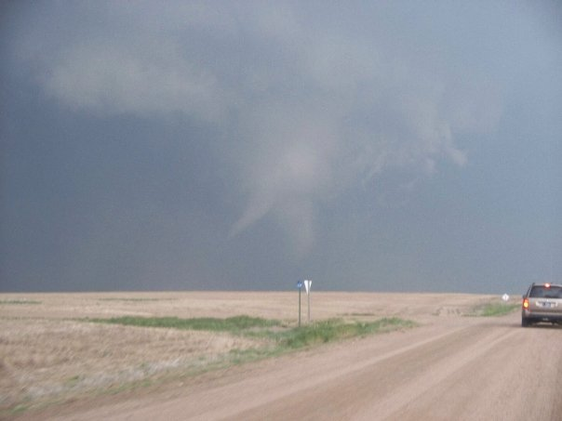
Multi-vortex rotation. (twin funnels)

Slide 13
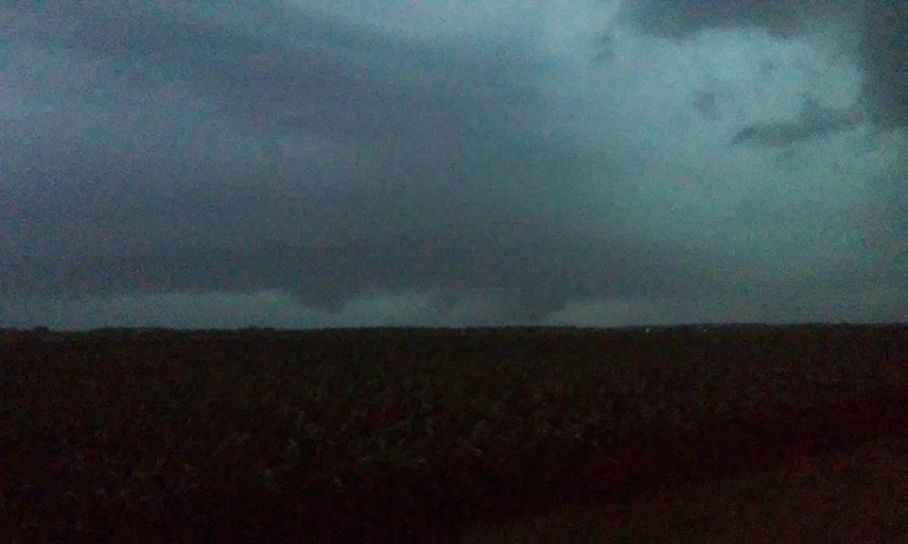
Rotating wall cloud, tornado.

Slide 14
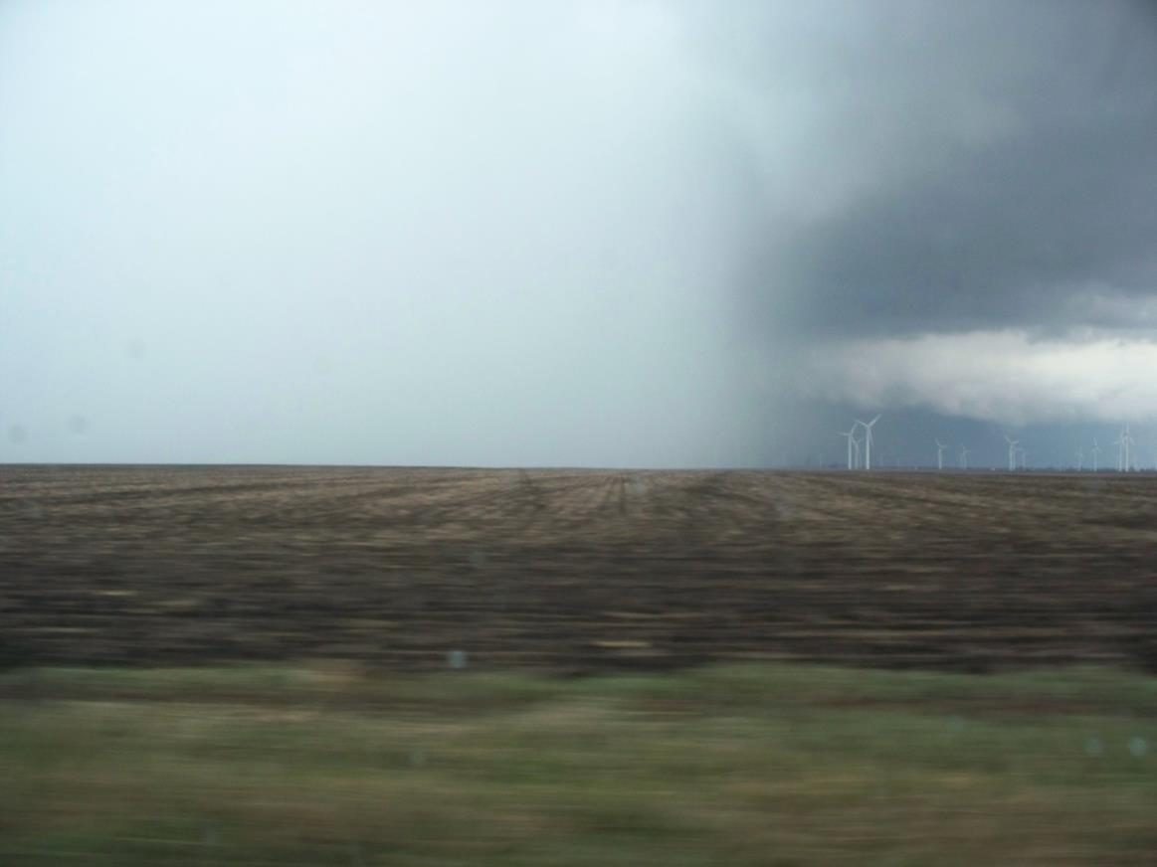
Thunderstorm with hail/heavy rain.

Slide 15
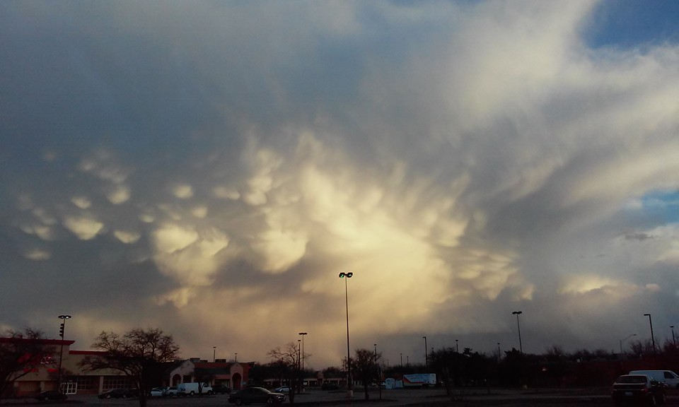
Mammatus clouds, hail shafts, anvil cloud.

Slide 16
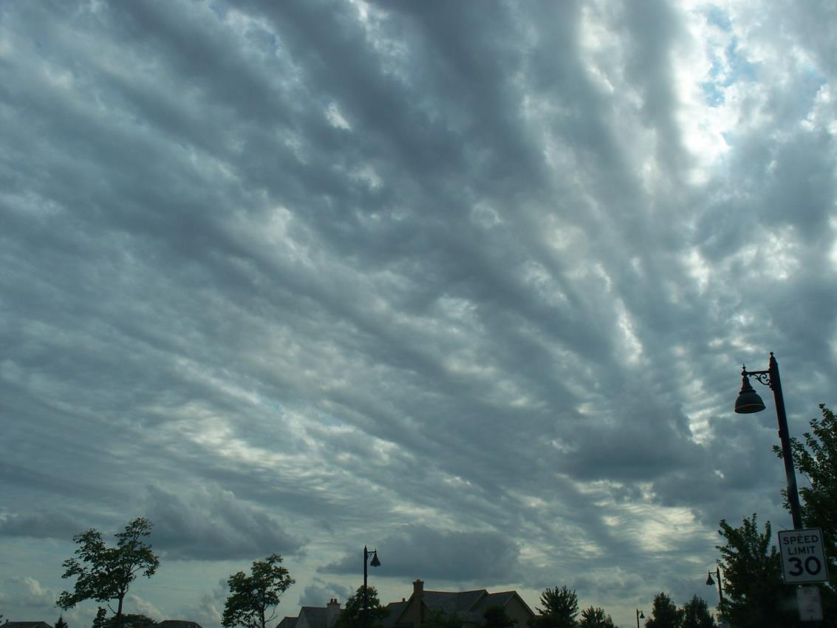
Gravity waves, atmosphere unstable.

Slide 17
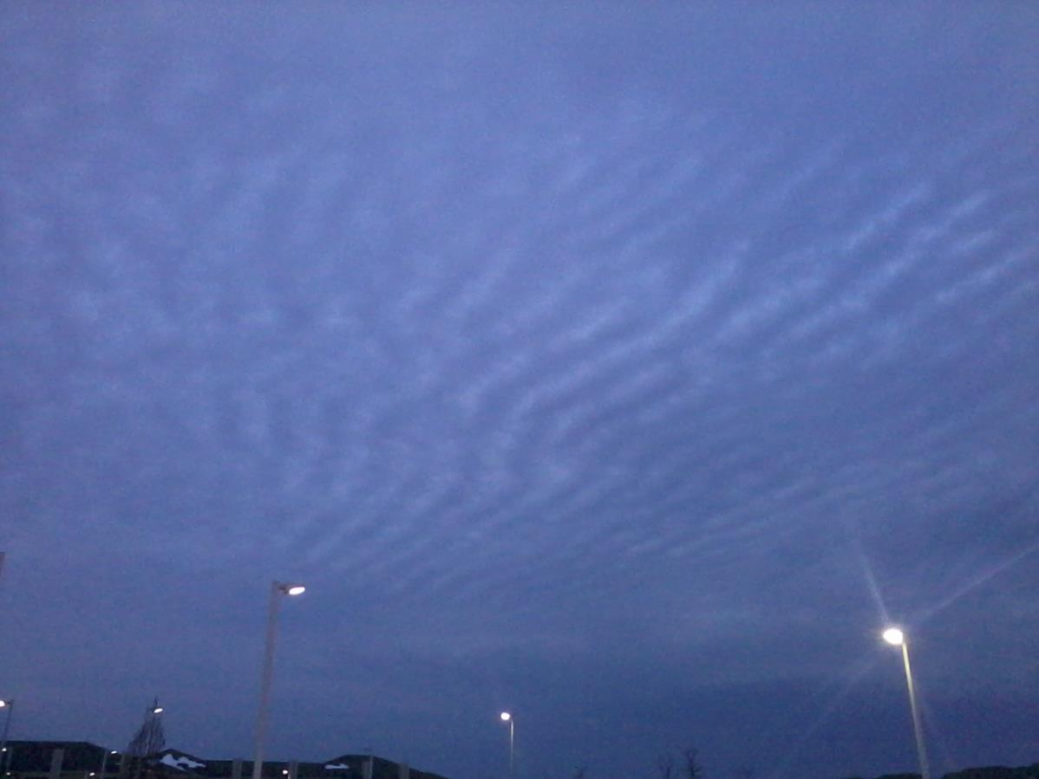
More gravity waves.

Slide 18
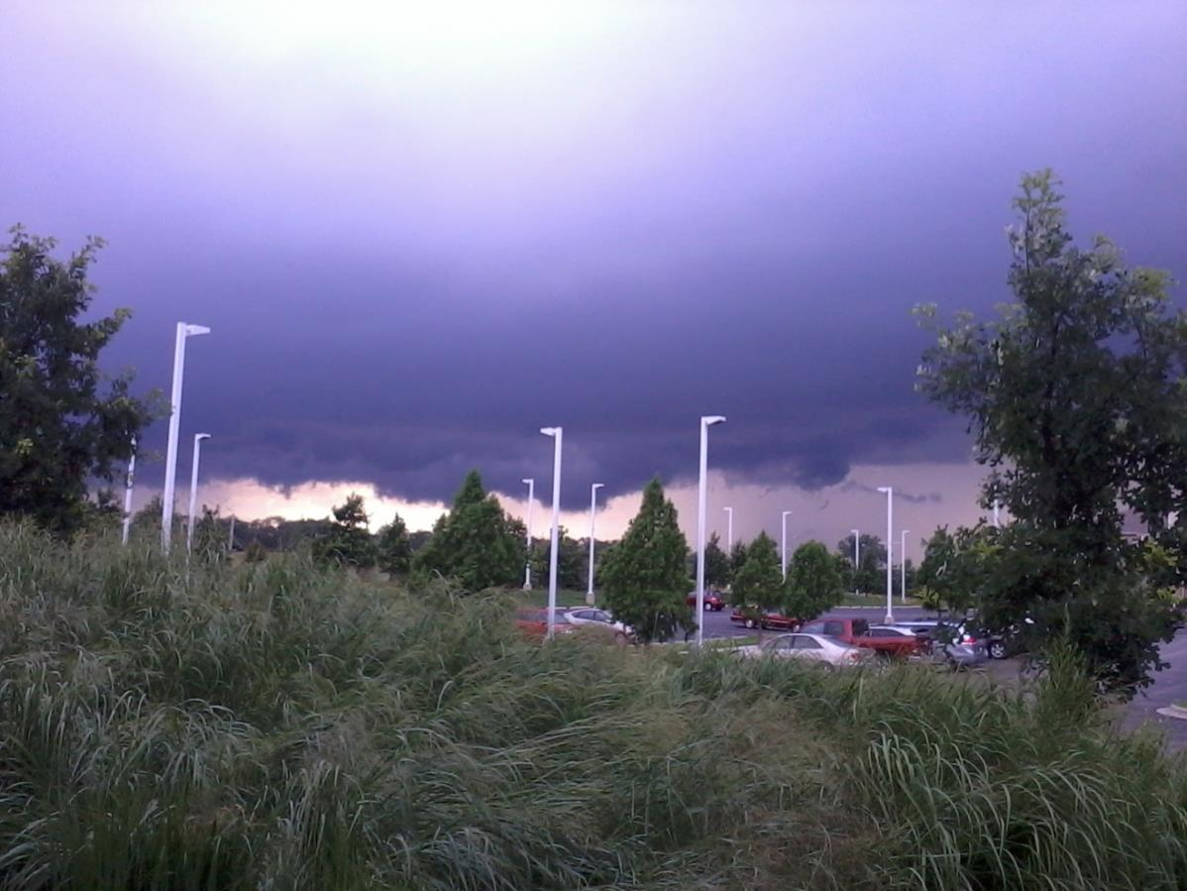
Non-rotating lowering. (false funnels)

Slide 19
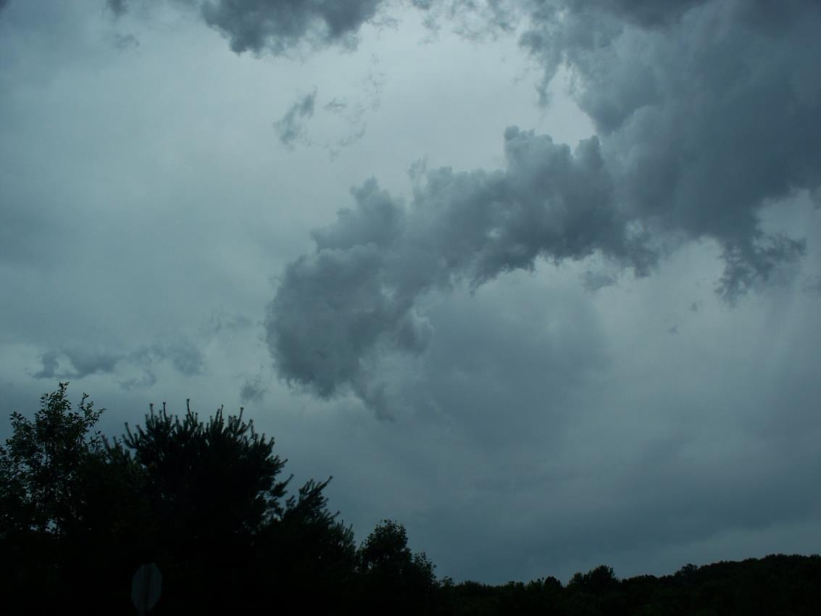
Another non-rotating lowering.

Slide 20
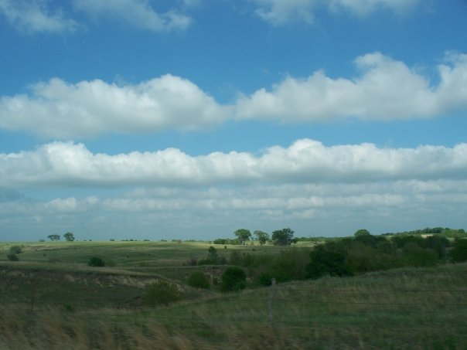
Outflows from cold fronts help cause the roll clouds.

Slide 21
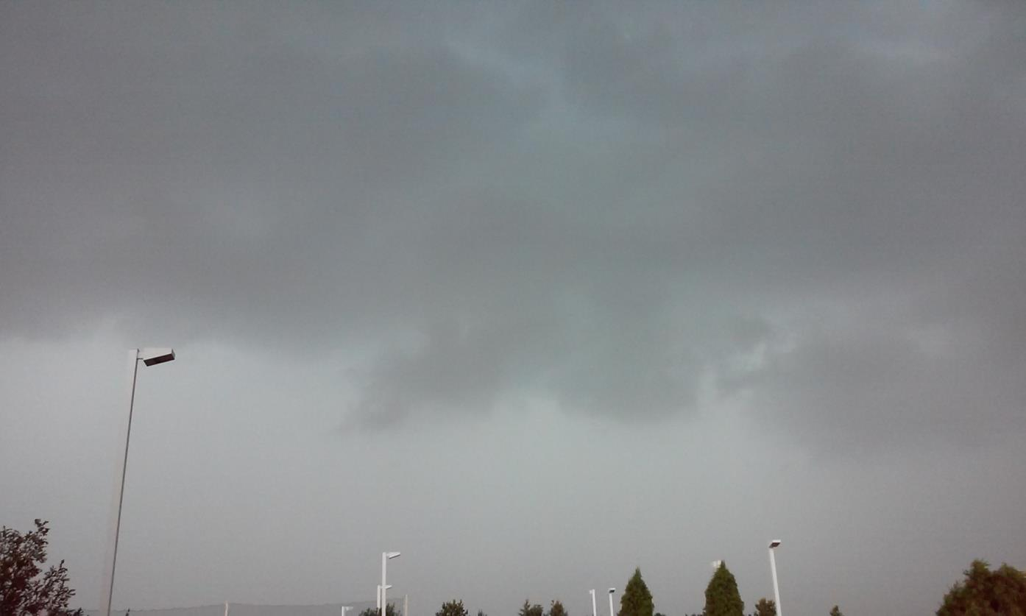
Rain line.

Slide 22
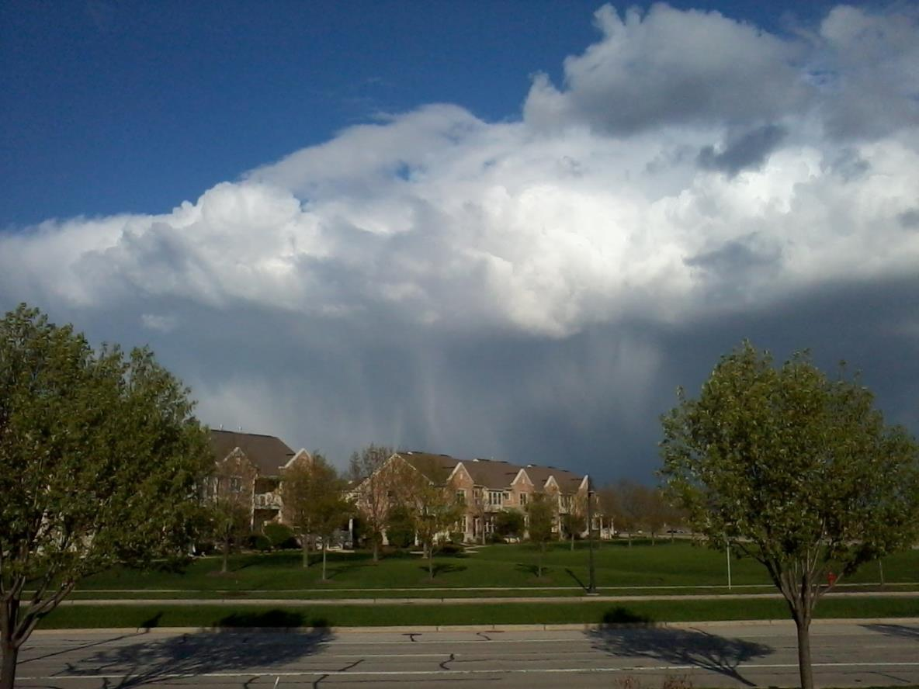
Snow/rain mix.

Slide 23
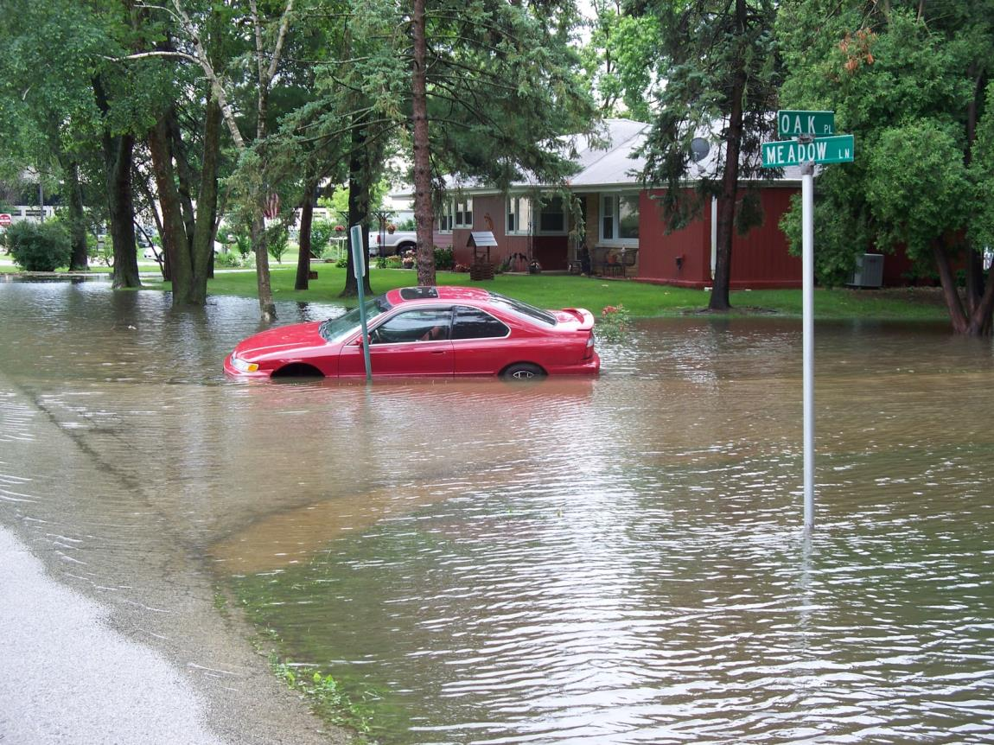
Turn around, don’t drown.

Slide 24
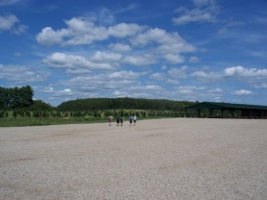
Fair weather clouds.

Slide 25
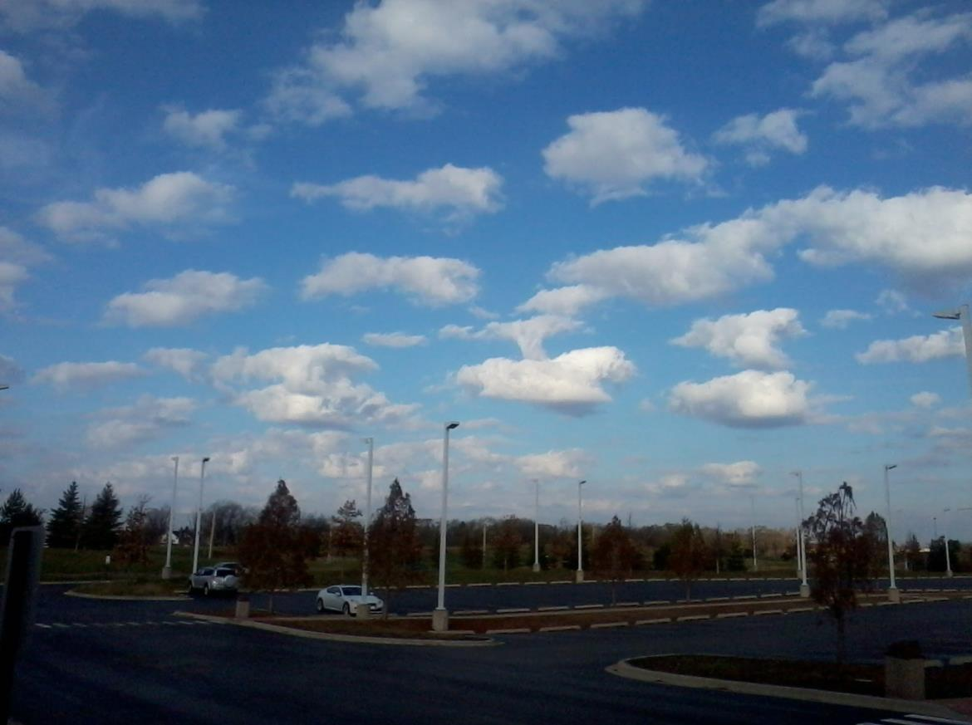
Fair weather cumulus.

Slide 26
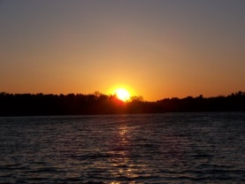
Keep your eyes on the skies and be weather aware!

